Slide 1
HARDPOINT HACKATHON
DOCPOTION
the alchemist for your documents
TEAM AI ALCHEMISTS
MEENAKSHY N S
NANDHANA A R
NEERAJA KRISHNAKUMAR
A ARDRA NAIR
BINIL BABU P

Slide 2
PROBLEM STATEMENT
Create a model to automatically extract title and author information from documents, and generate alternative titles relevant to the document's contents.

Slide 3
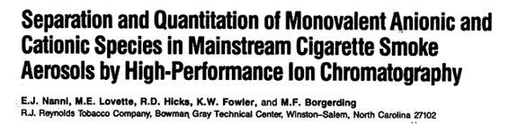
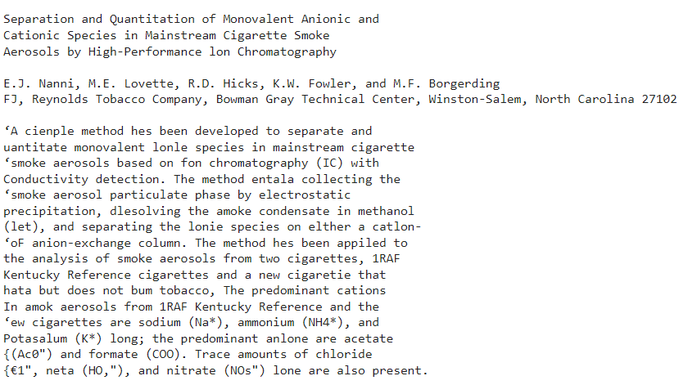
PREPROCESSING
Preparing documents for accurate analysis is crucial.
OCR with Pytesseract: Converts scanned images to editable text

Slide 4
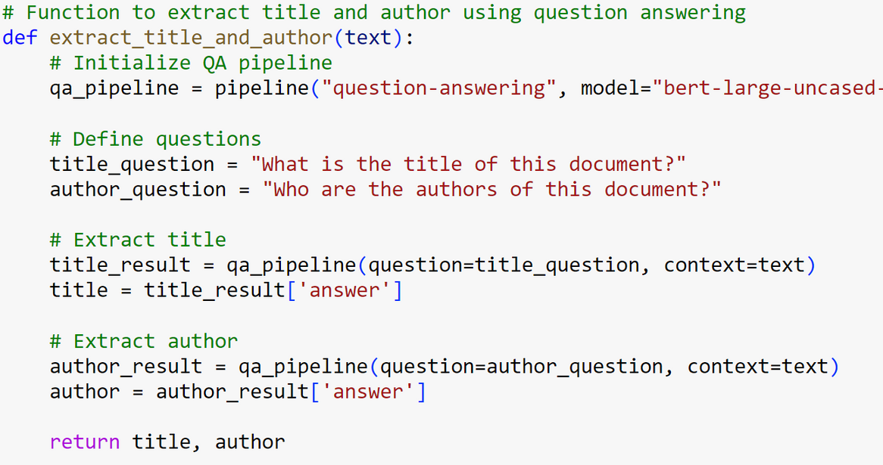
EXTRACTION
Hugging Face Library Integration: Integration of Hugging Face's library to execute the question-answering module for precise extraction of document titles and authors
Question-Answering Method: Formulates questions related to titles and authors to accurately identify and extract relevant information

Slide 5
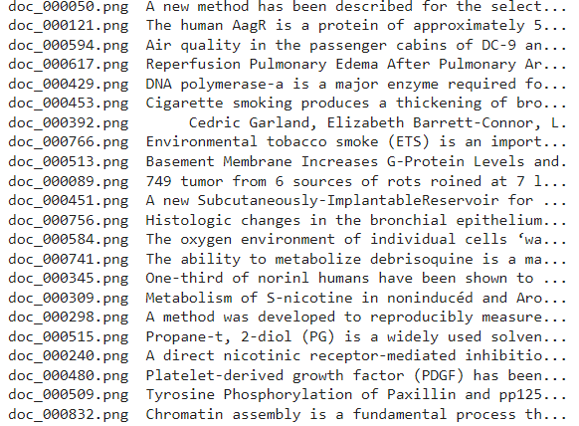
GENERATION
BART, a powerful language generation model, is employed to generate alternative titles
By analyzing document content, BART suggests captivating titles

Slide 6
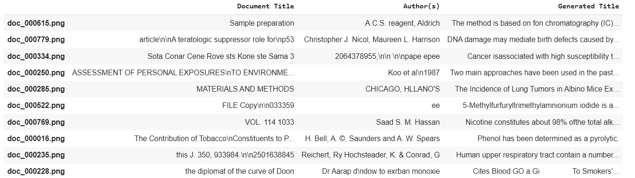
DATA CLEANING
The document titles and generated titles are run through a spell checking module to ensure clarity
Installed pyspellchecker to use SpellChecker
Unprocessed text in image

Slide 7
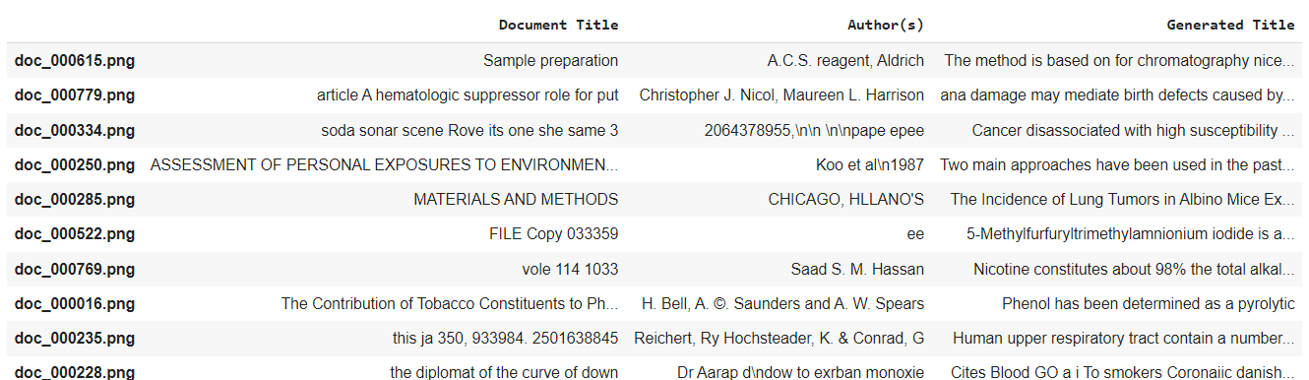
OUR SOLUTION
Introducing our efficient document analysis tool! By harnessing the power of advanced NLP methods like OCR and question-answering, we've simplified the process of extracting crucial information from scanned documents. With our solution, users can swiftly access document titles, author names, and receive alternative title suggestions.

Slide 8
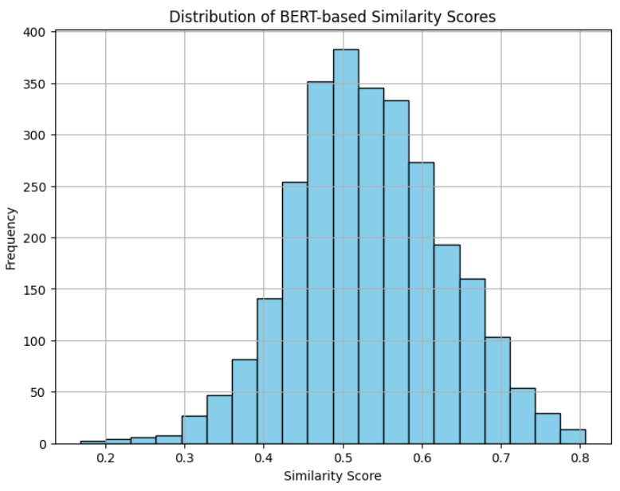
RESULT ANALYSIS
The histogram illustrates the distribution of BERT-based similarity scores between original document titles and their generated alternatives, showcasing the system's accuracy in producing titles closely matching the originals

Slide 9
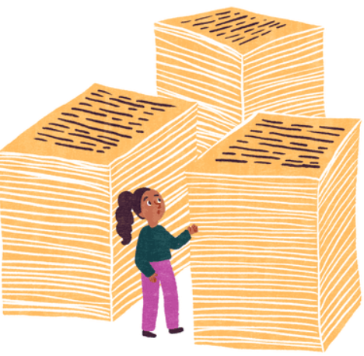
TARGET AUDIENCE
KEY TECHNOLOGIES
Researchers
Librarians
Information Scientists
PyTesseract (OCR)
Transformers & SentencePiece (NLP)
Pandas (Data Analysis)
Pyspellchecker (Spell Checking)
Cosine Similarity Score (Evaluation Metric)

Slide 10
CHALLENGES FACED
FUTURE SCOPE
Data Cleaning: Removing publication details to improve title extraction accuracy
Keyword-Based Recommendations: Analyzing keywords to suggest similar articles
Short Summaries: Generating concise summaries using NLP
Noisy Data: Dealing with scanned documents led to noisy text, affecting the accuracy of text extraction
Limited Data: The dataset is limited in size and diversity

